Slide 1
USC Viterbian -redesign myViterbi.com
Shuoqing Ding
Chenxin Guo
Kaixi Liu
Guanghao Peng
Wenyuan Zhu

Slide 2


Motivation
Feedback?
Errors?
Action Reversal?
IN CONTROL??!!!!

Slide 3
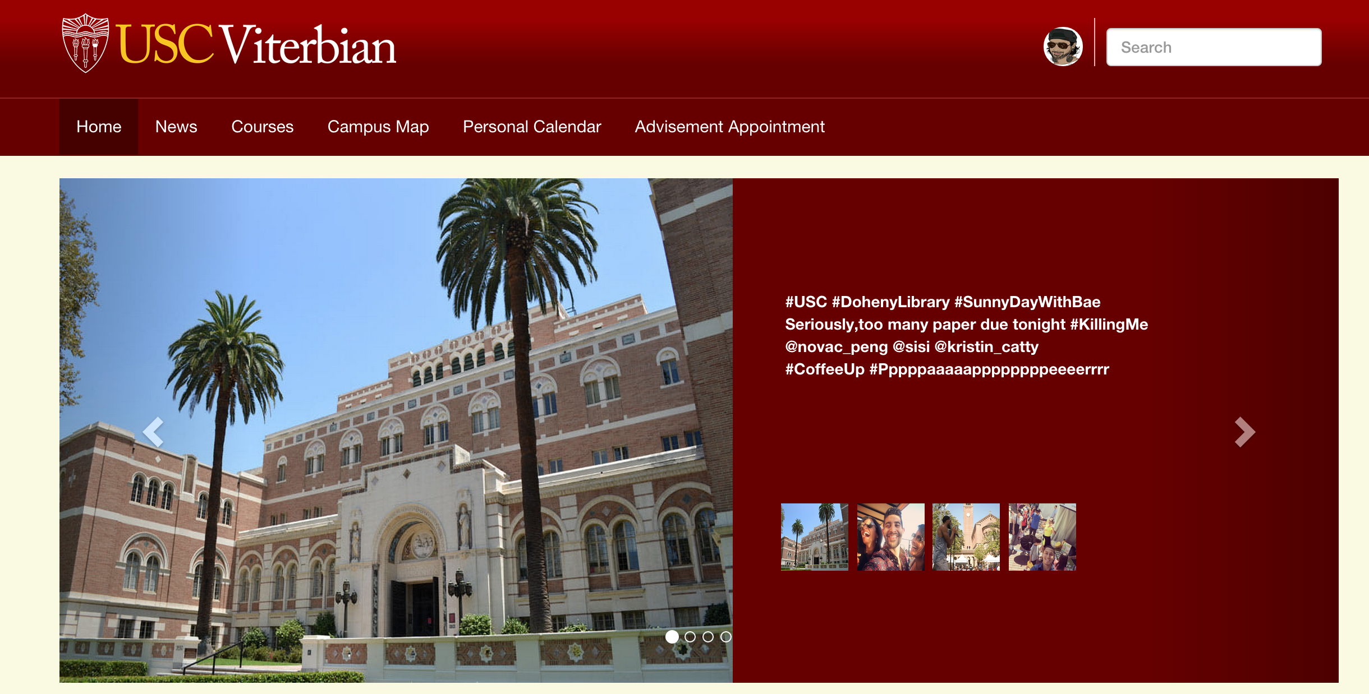
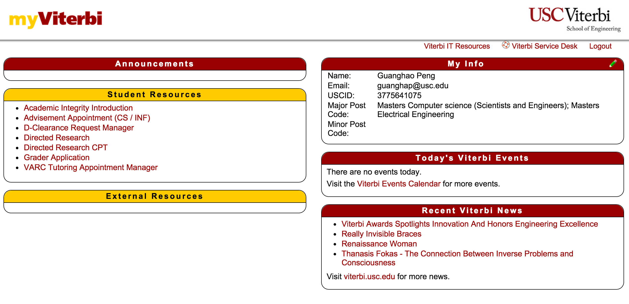
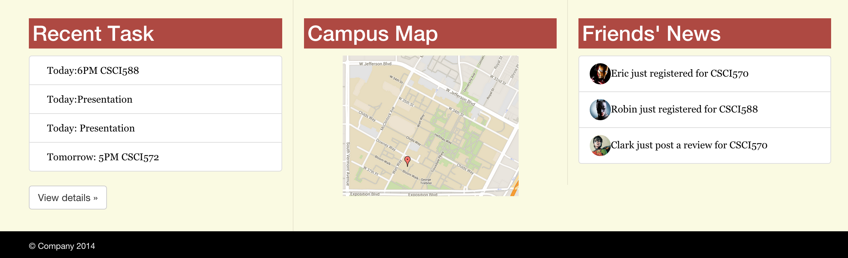
HOW?
.
Solution: Using eight golden rules to Redesign.

Slide 4

Technical
.
Bootstrap
jQuery
Google Map API
Instagram API
Etc.

Slide 5


Navigation Bar
.
Consistency?
Usability?
Prevent Errors?
Control?
Reduce Memory Load?

Slide 6
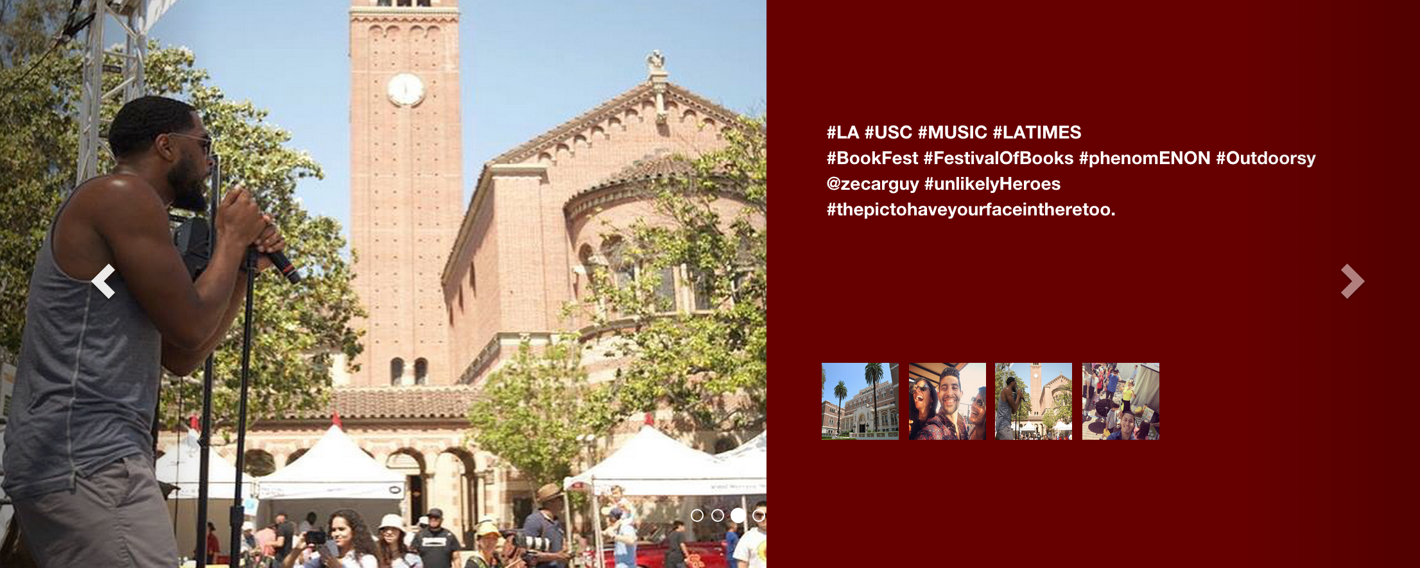
News VS. Instagram
.

Slide 7
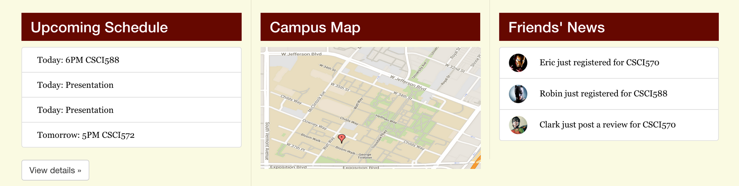

YOU decide what is in main part

Slide 8

USC News

Slide 9
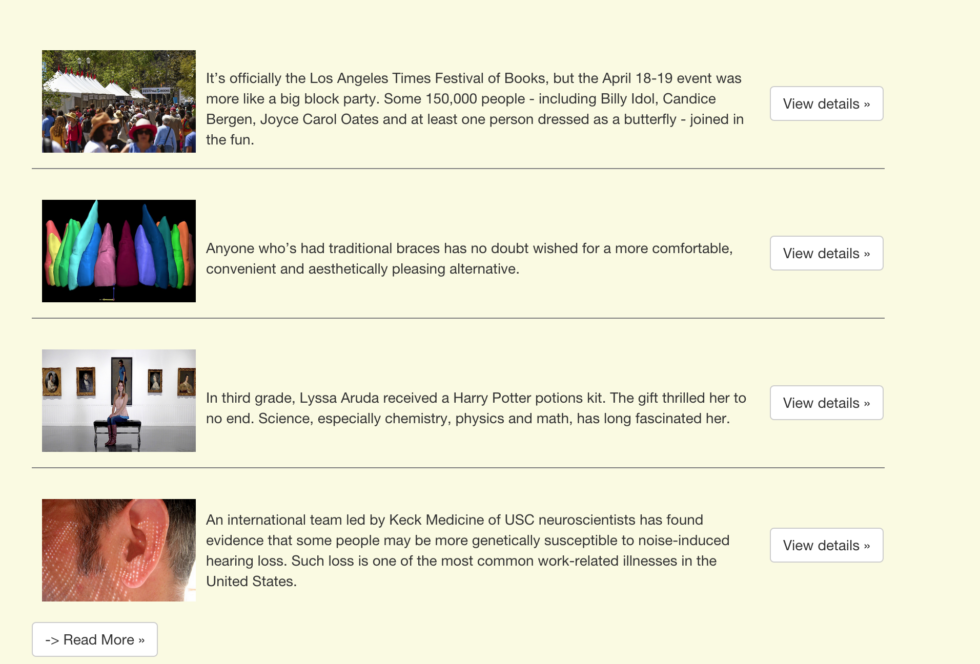
USC News

Slide 10
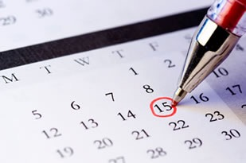
Making Appointment

Slide 11
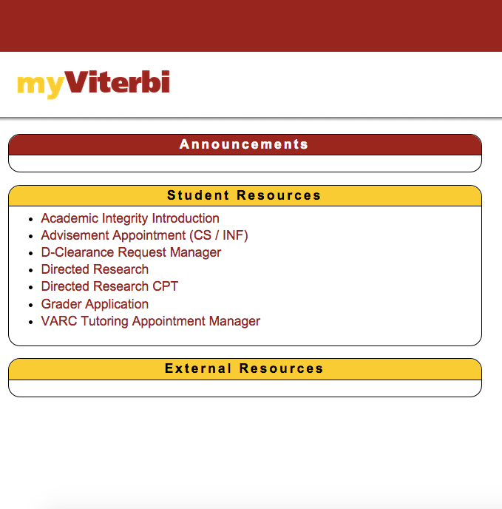
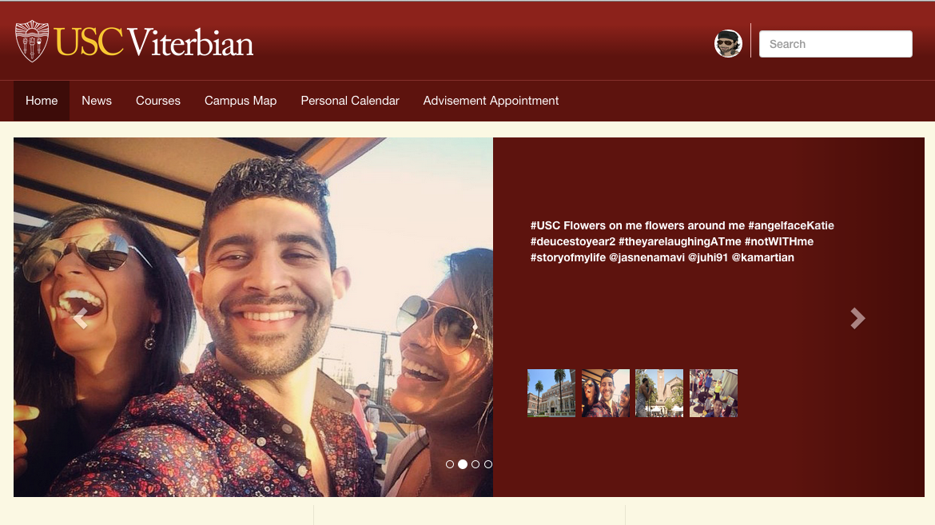
Access

Slide 12
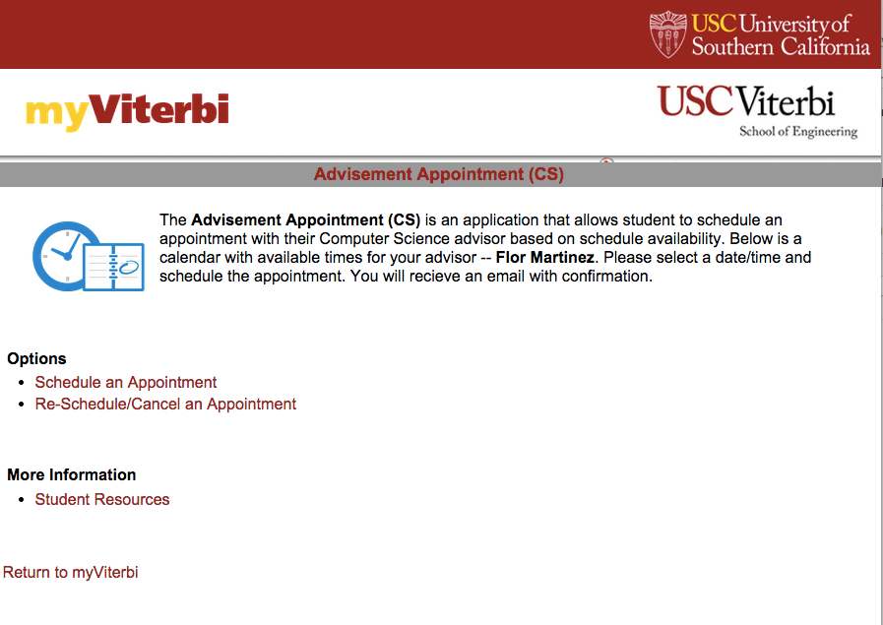
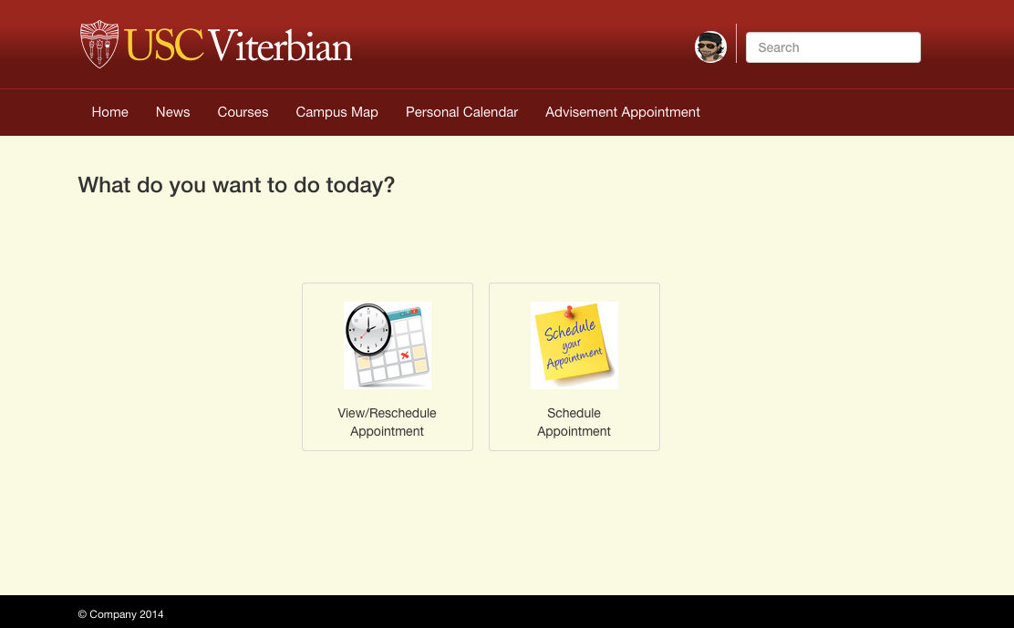

Slide 13
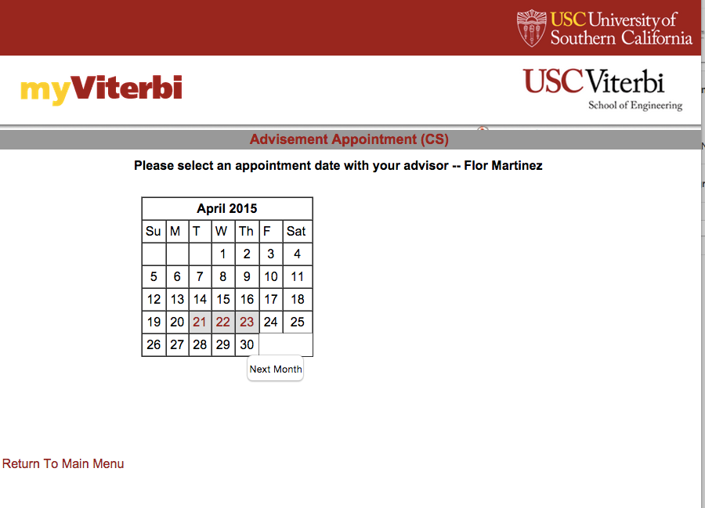
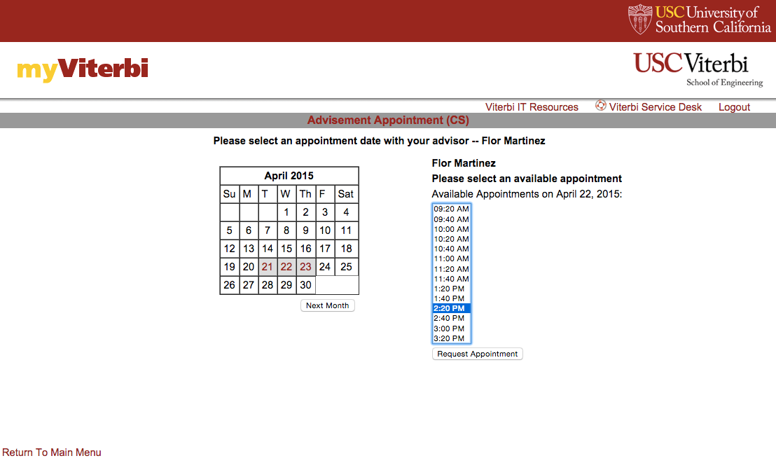
Schedule Appointment

Slide 14
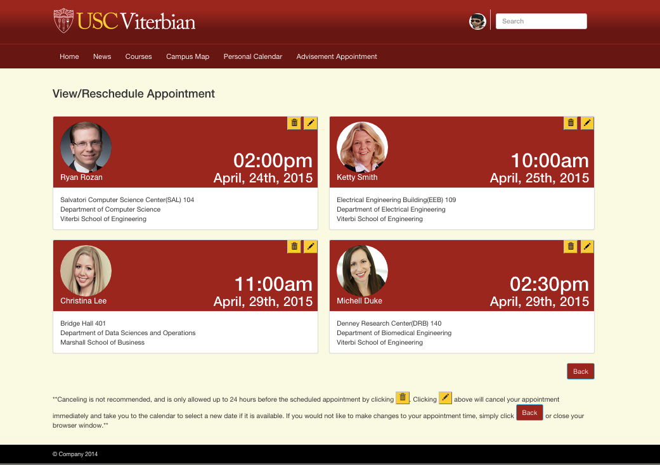
View/Reschedule Appointment

Slide 15
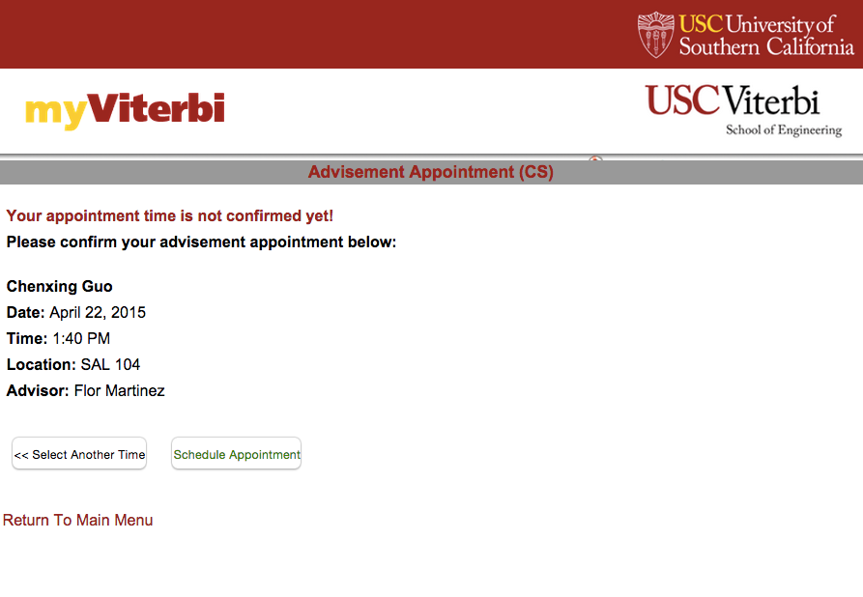
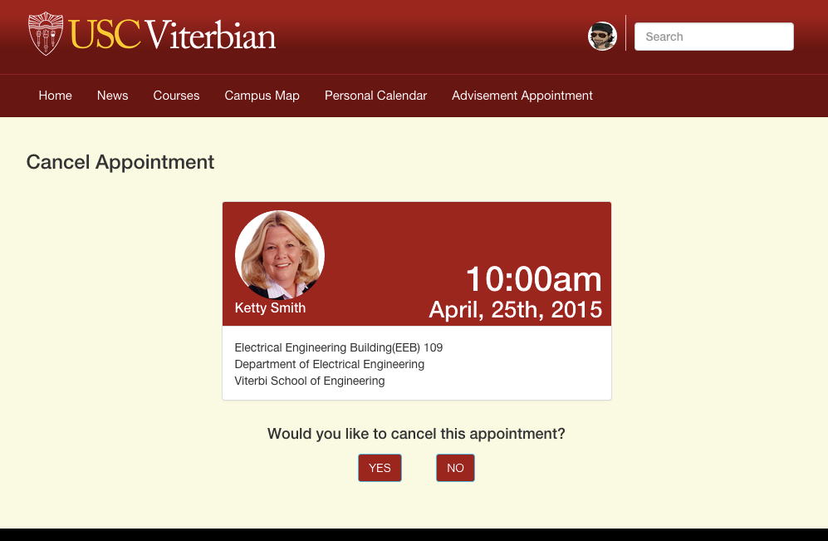
Cancel Appointment

Slide 16
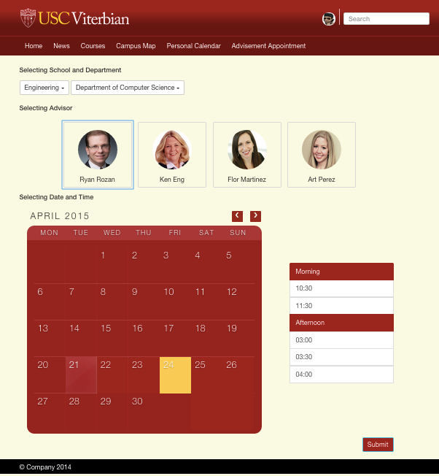
Reschedule Appointment

Slide 17

USC Map

Slide 18
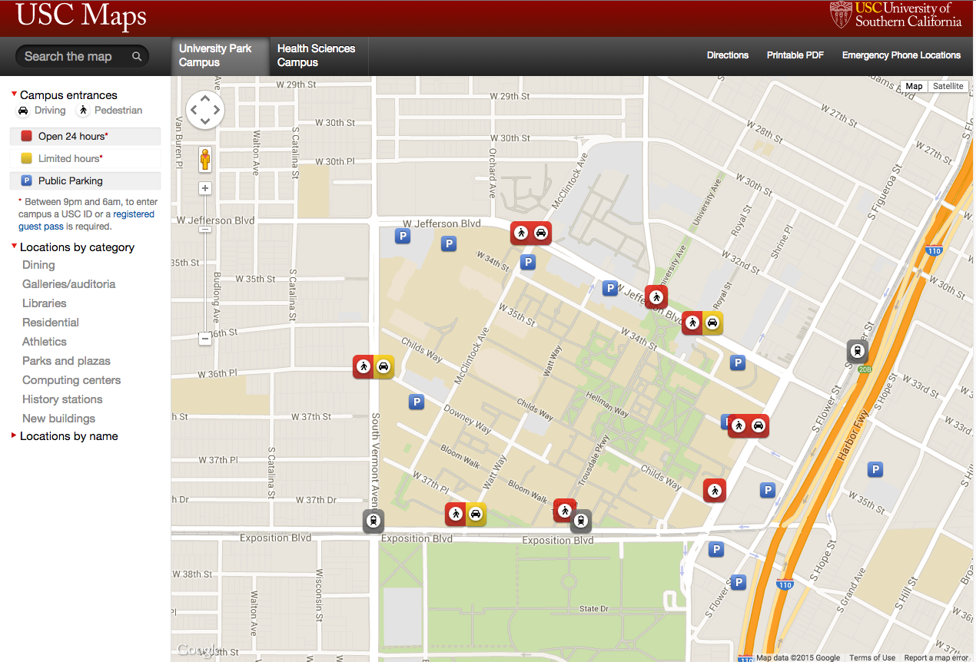
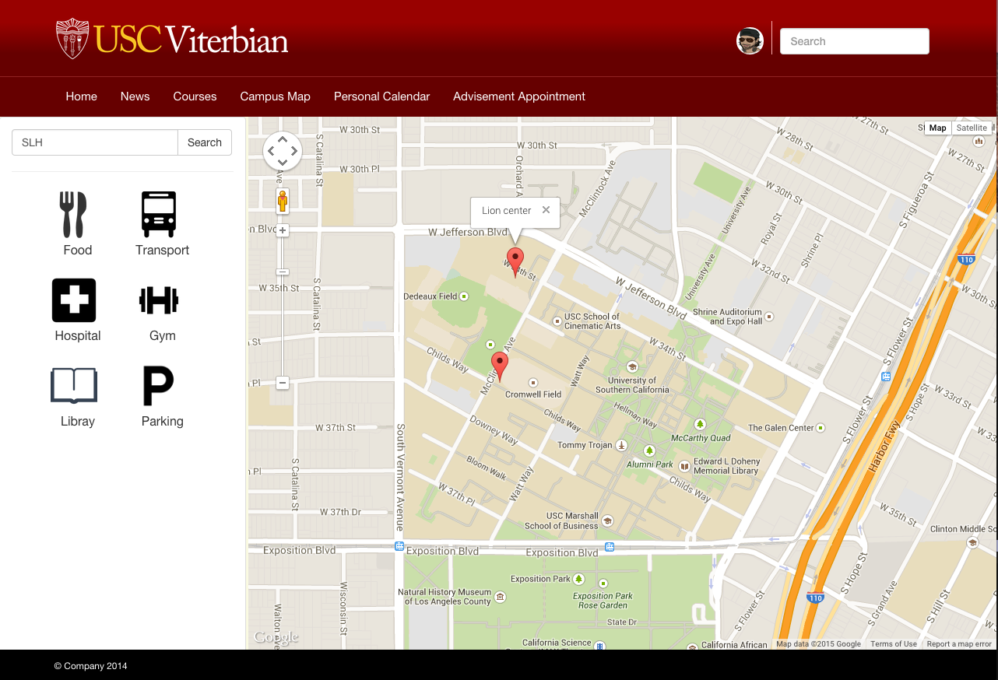
USC Map

Slide 19
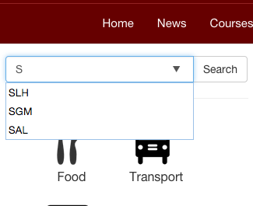
USC Map
Search Autocomplete
Icons
Less options = easy for users

Slide 20

Calendar

Slide 21
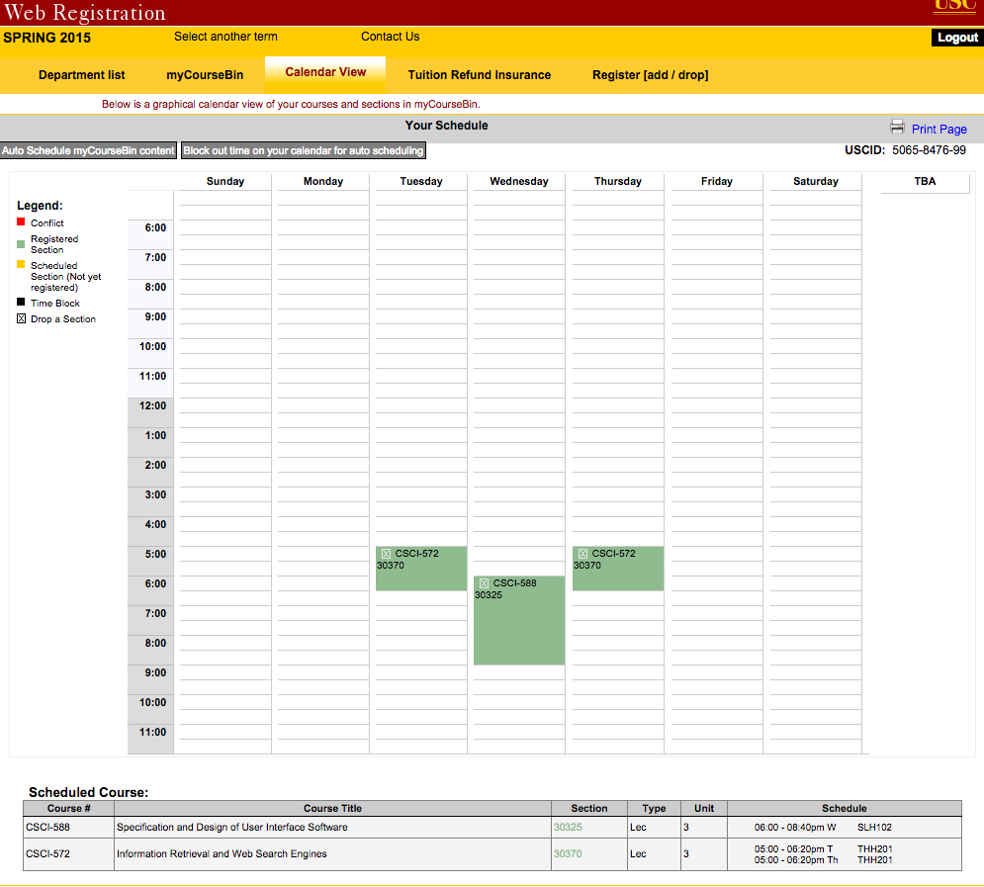
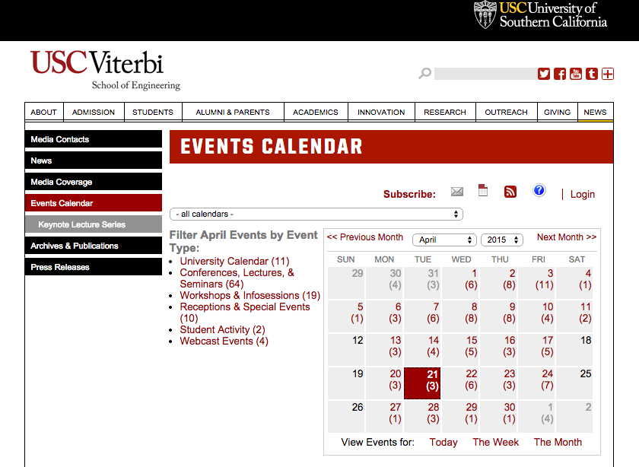
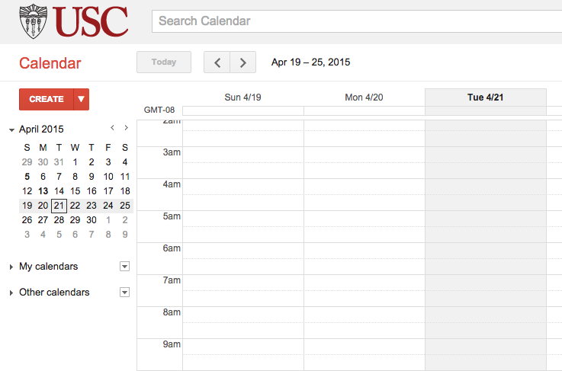
USC Calendars

Slide 22
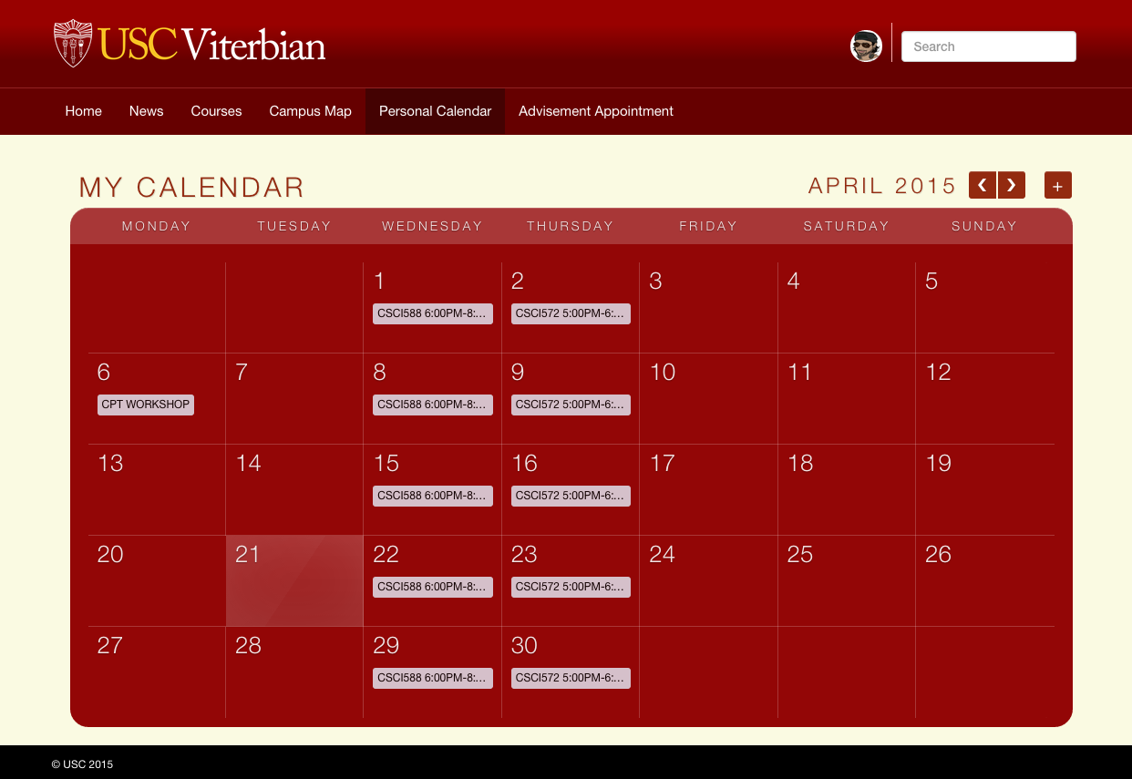
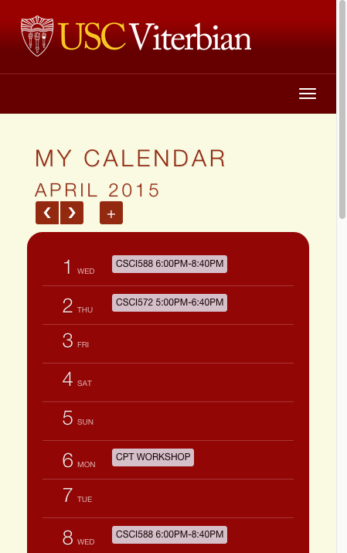
One calendar to rule them all

Slide 23
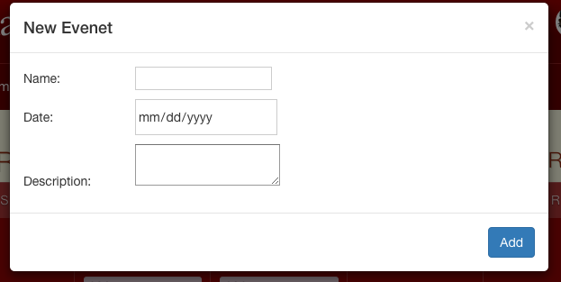
My Calendar
Classes
My Events
Customized Events

Slide 24

Dashboard

Slide 25
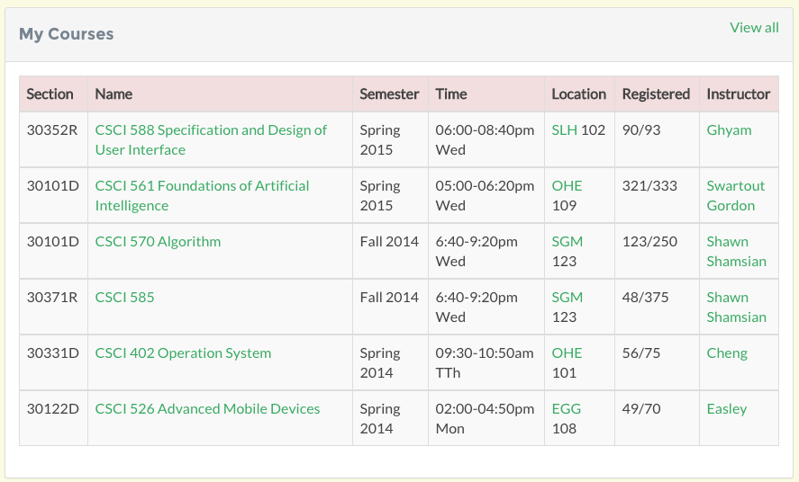
Show all the courses I take in USC in my dashboard page

Slide 26
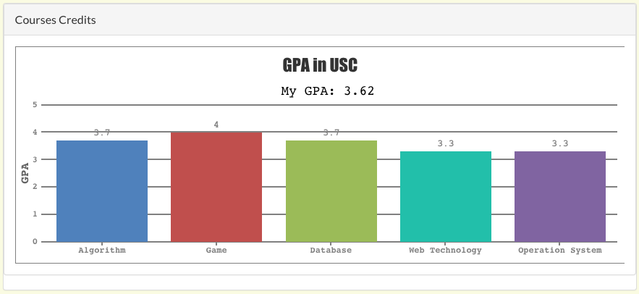
Present GPA for my courses

Slide 27
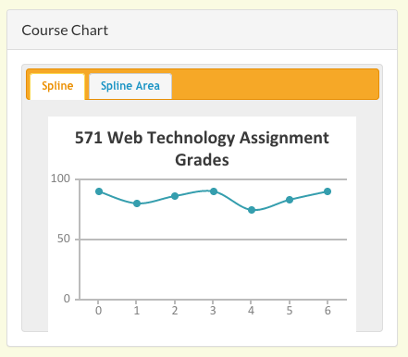
Show all assignments’ grade in a specific course

Slide 28

Course classmates & Friends page

Slide 29
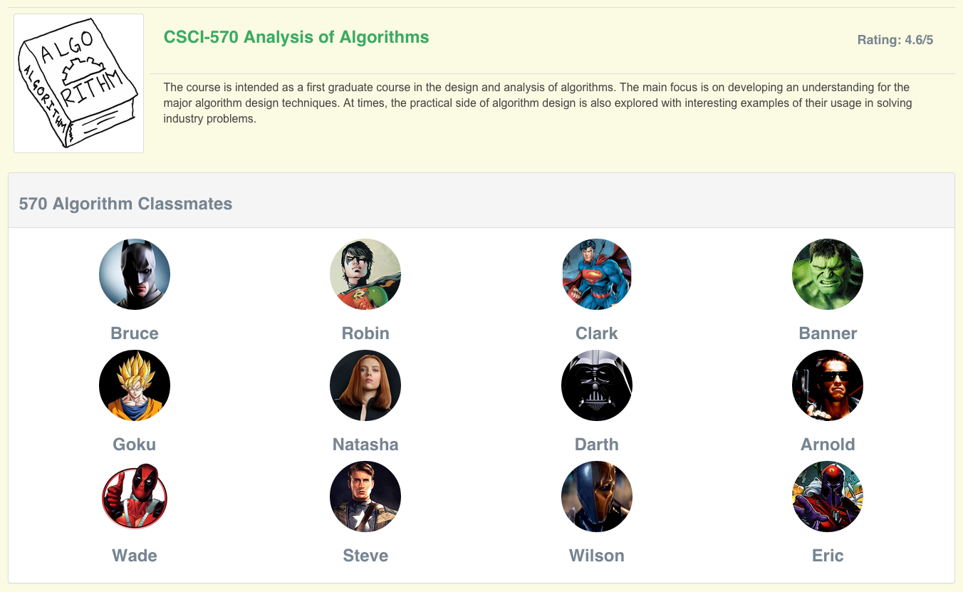
We can find all our classmates in a specific class

Slide 30
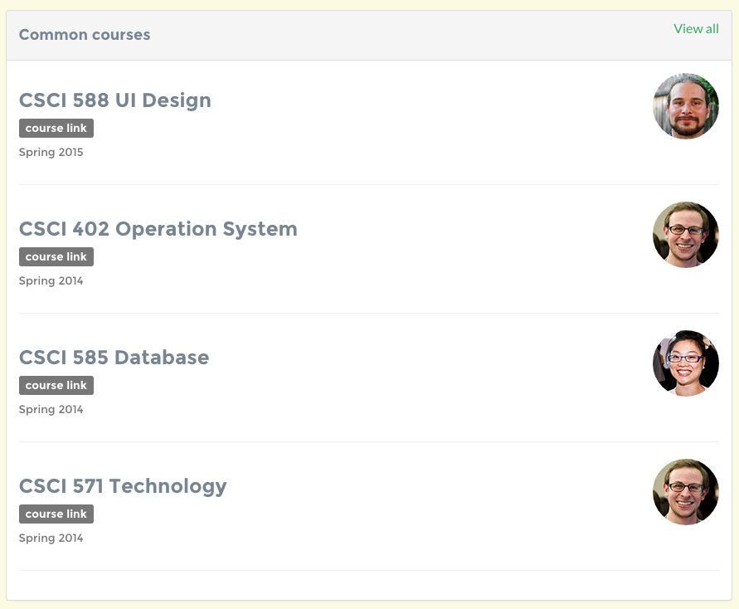
Common courses with my friend

Slide 31
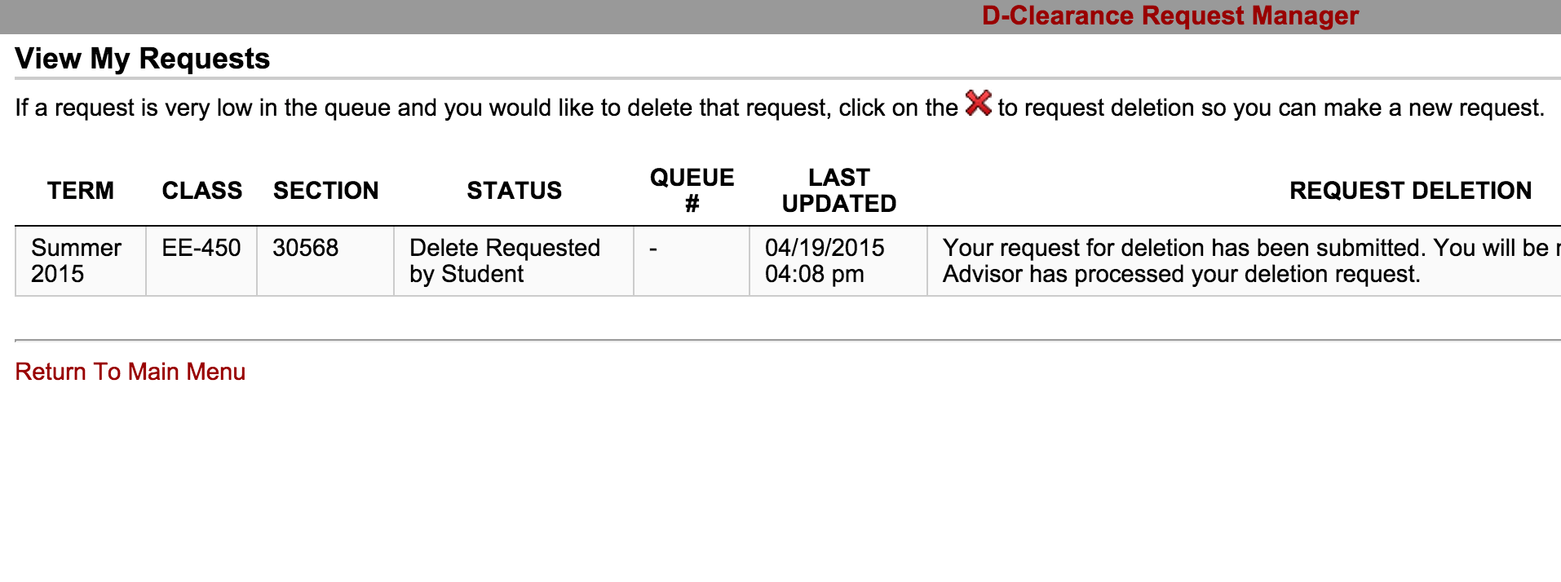
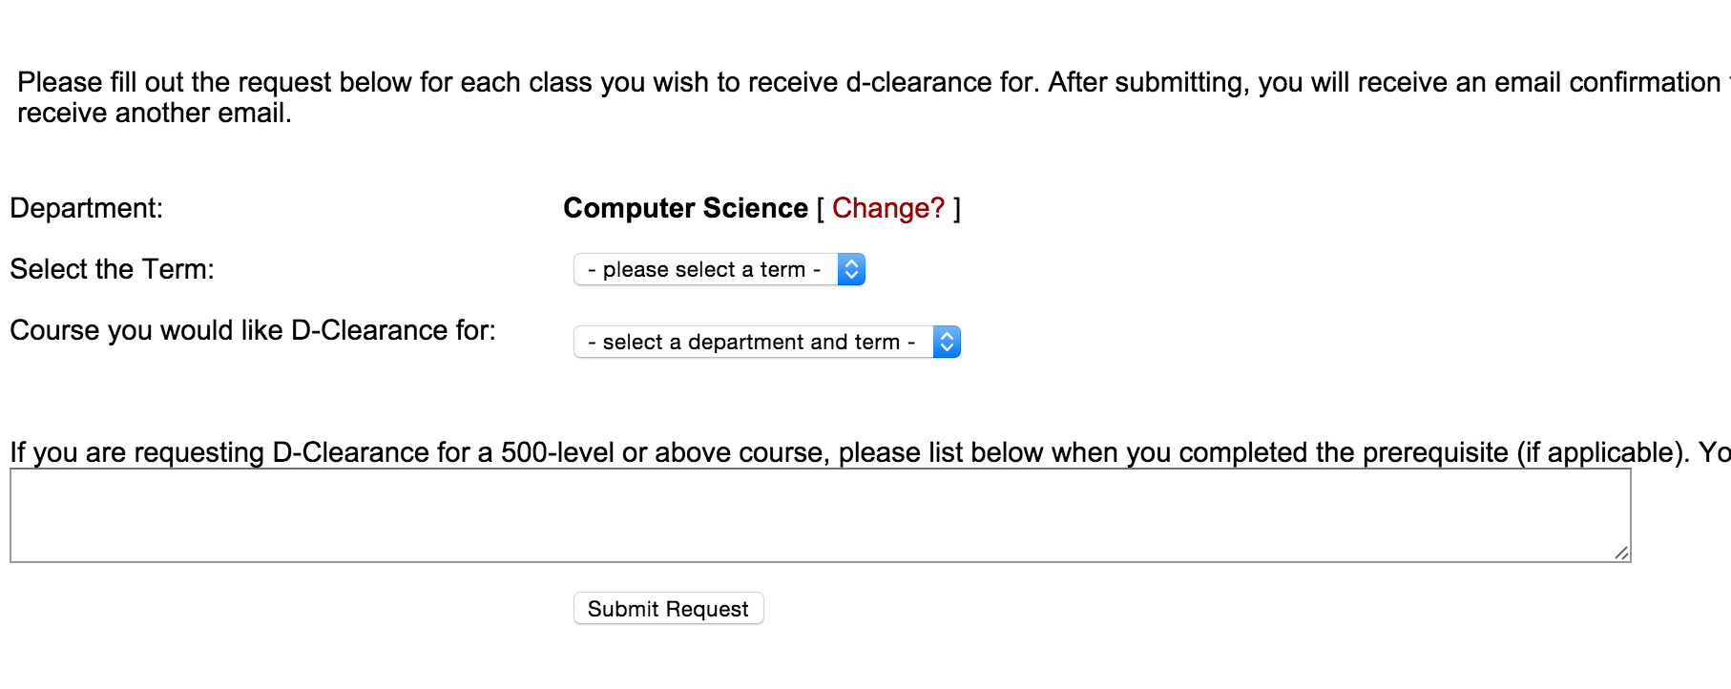
The old D-Clearance System

Slide 32
My D-Clearance System
Graphical UI
Support for Course Information
Support professor lookup
Student Reviews offer meaningful feedbacks
Offer rating function

Slide 33
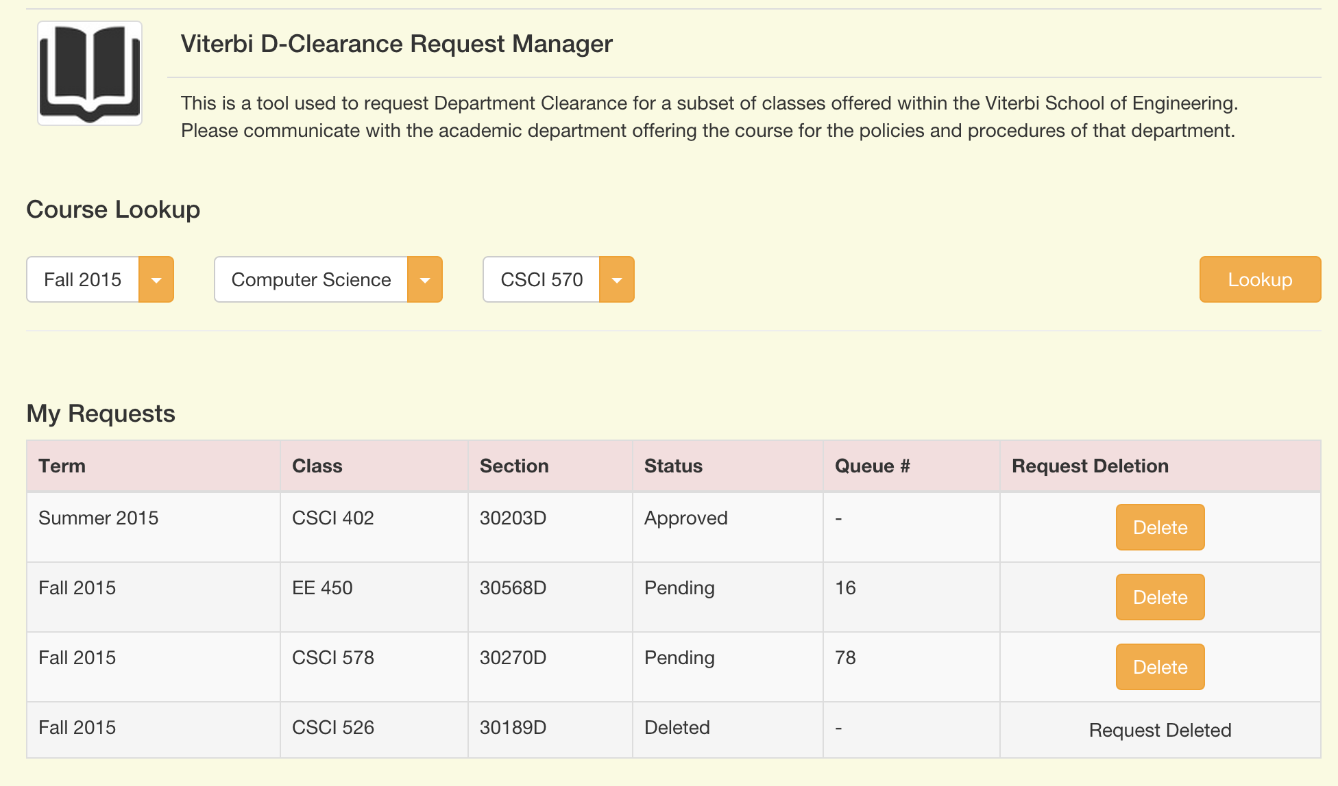
Straight Forward UI

Slide 34
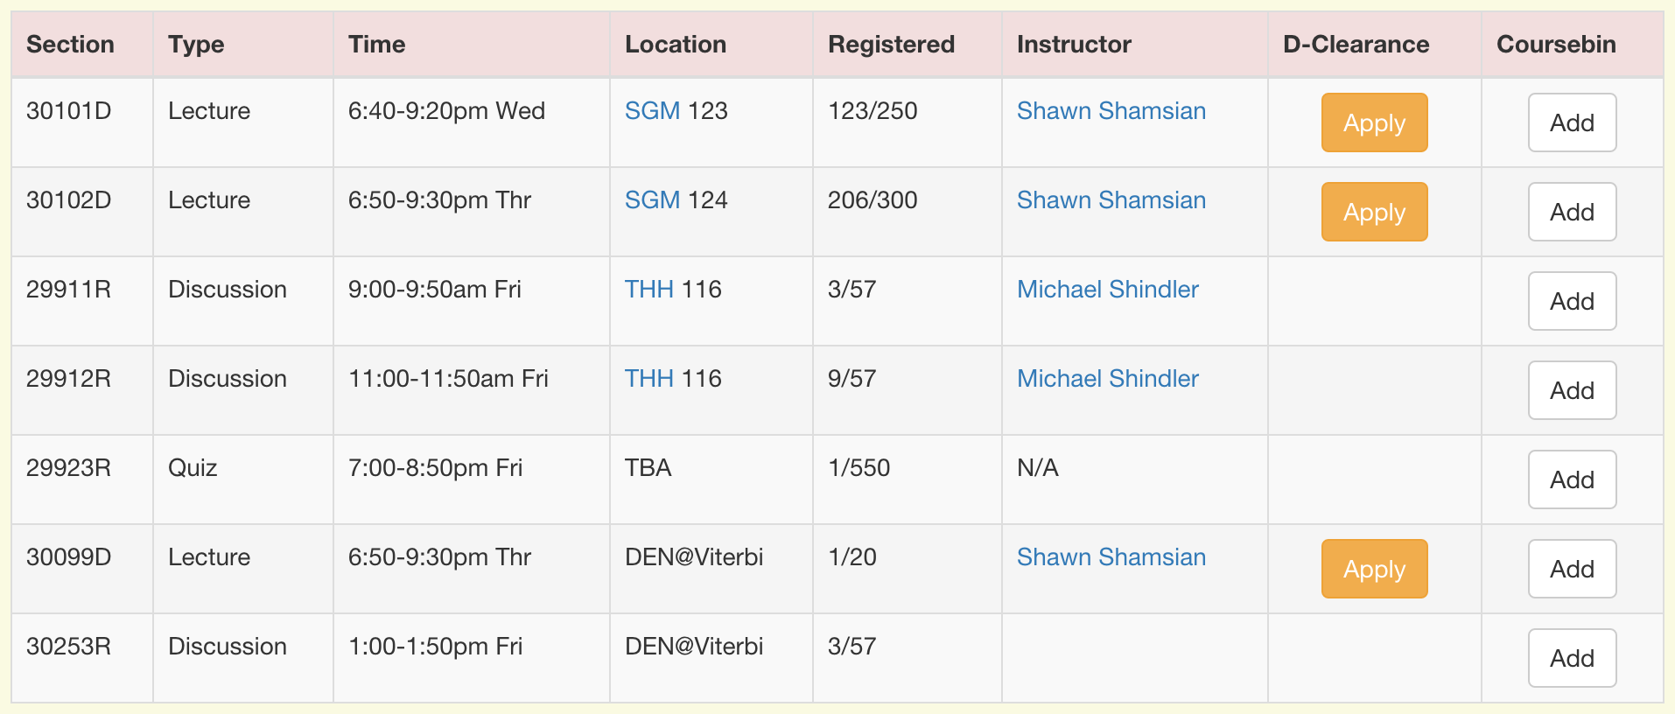
Easy to Apply

Slide 35
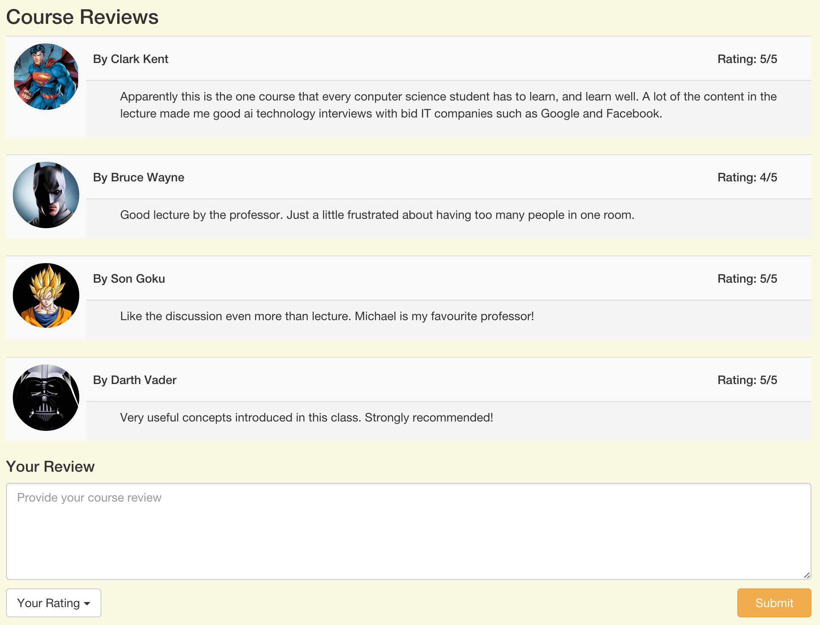
Review Interactions

